Slide 1
Disjoint-set operations , Linked-list representation of disjoint sets
By
Mr. GURURAJ
Assistant Professor-Selection Grade
Department of Computer Science & Engineering
M.I.T Manipal

Slide 2
Disjoint-set operations
Some applications involve grouping n distinct elements into a collection of disjoint sets.
Common operations- finding the unique set that contains a given element and uniting two sets.
A disjoint-set data structure maintains a collection s= {S1,S2,……,Sk} of disjoint dynamic sets.
Disjoint set Operations:
MAKE-SET(x)→ creates a new set whose only member (and thus representative) is x. Since the sets are disjoint, we require that x not already be in some other set.
UNION(x, y) unites the dynamic sets that contain x and y, say Sx and Sy, into a new set that is the union of these two sets.

Slide 3
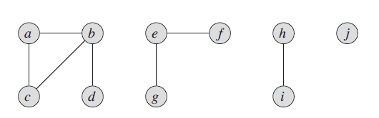
Disjoint-set operations
FIND-SET (x) returns a pointer to the representative of the (unique) set containing x.
Analyze the running times of disjoint-set data structures in terms of two parameters: n, the number of MAKE-SET operations, and m, the total number of MAKE-SET, UNION, and FIND-SET operations.

Slide 4
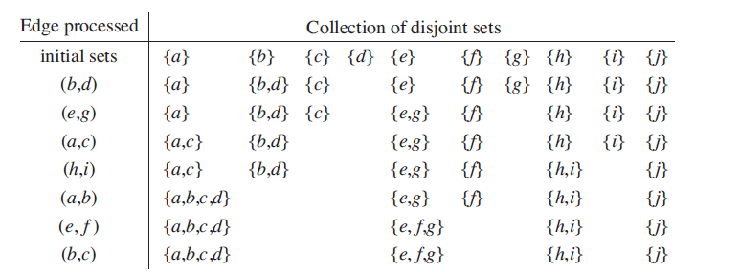
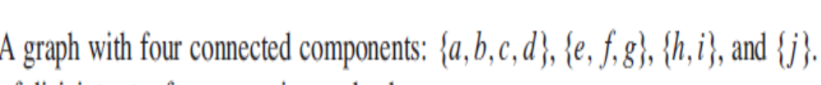
Disjoint-set operations

Slide 5
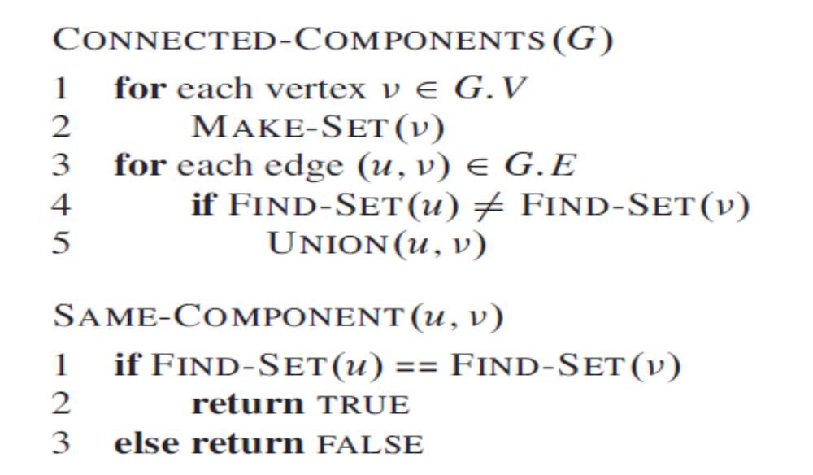
Disjoint-set operations

Slide 6
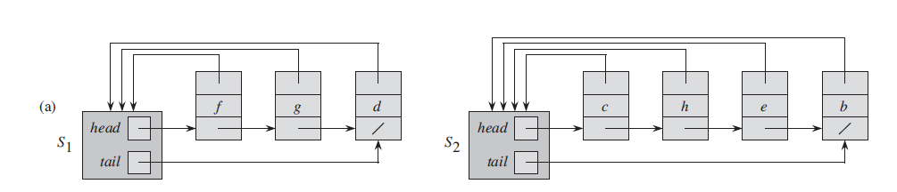
Linked-list representation of disjoint sets
A simple way to implement a disjoint-set data structure is to represent each set by a linked list.
The object for each set has attributes head, pointing to the first object in the list, and tail, pointing to the last object.

Slide 7
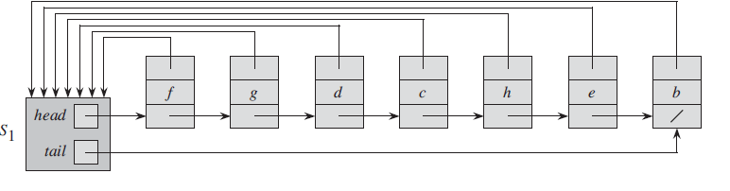
Linked-list representation of disjoint sets
Union (g,e)

Slide 8
Disjoint-set operations
A simple implementation of union
Appending x’s list onto the end of y’s list.
The representative of x’s list becomes the representative of the
resulting set.
Update the pointer to the set object for each object originally
on y’s list, which takes time linear in the length of y’s list.

Slide 9
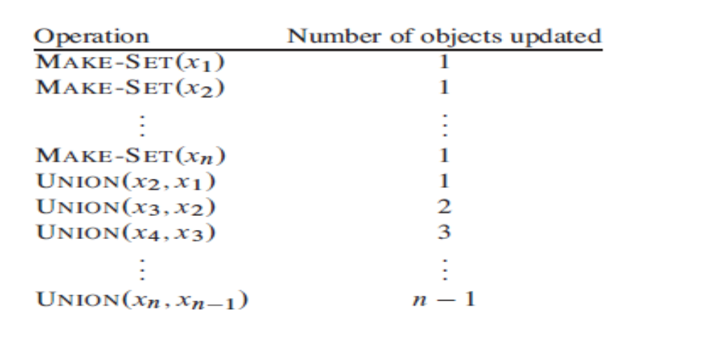
Disjoint-set operations

Slide 10
Disjoint-set operations
A weighted-union heuristic
In the worst case, the above implementation of the UNION procedure requires an
average of ϴ(n) time per call because we may be appending a longer list onto
a shorter list.
we must update the pointer to the set object for each member of the longer list.
Suppose instead that each list also includes the length of the list and that we always append the shorter list onto the longer, breaking ties arbitrarily.
With this simple weighted-union heuristic, a single UNION operation can still take Ω(n) time if both sets have Ω(n) members.
As the following theorem shows, however, a sequence of m MAKE-SET, UNION, and
FIND-SET operations, n of which are MAKE-SET operations, takes O(m + n lg n) time.

Slide 11
Using the linked-list representation of disjoint sets and the weighted-union heuristic, a sequence of m MAKE-SET, UNION, and FIND-SET operations, n of which are MAKE-SET operations, takes O(m + n lg n) time.
Consider a particular object x. We know that each time x’s pointer was updated, x must have started in the smaller set. The first time x’s pointer was updated, therefore, the resulting set must have had at least 2 members. Similarly, the next time x’s pointer was updated, the resulting set must have had at least 4 members. Continuing on, we observe that for any k ≤ n, after x’s pointer has been updated lg k times, the resulting set must have at least k members. Since the largest set has at most n members, each object’s pointer is updated at most lg n times over all the UNION operations. Thus the total time spent updating object pointers over all UNION operations is O(n lg n). We must also account for updating the tail pointers and the list lengths, which take only ϴ(1) time per UNION operation. The total time spent in all UNION operations is thus O(n lg n).

